Slide 1
“Inflation inequalities across the euro area” IBFI Seminar « Monetary Policy» J. Montornes (BdF) 26 november 2025

Slide 2
introduction
What are the distributional effects of inflation?
This presentation examines the surge in the Euro area inflation and its heterogeneous impact across households since mid-2021
The distributional effects depend on the size and composition of the inflationary shock (i.e. energy and food products) along with household characteristics
Inflation impacts households through their expenditures (this presentation), income and wealth

Slide 3
Distributional Effects of inflation on Households’ wealth
In period of Inflation, wealth is “transfered” from creditors (lenders and savers) to debtors (borrowers), as the real value of debts diminishes
Inflation
real value of assets
real value of liabilities
Assets Liabilities
Cash / Deposits
Mortgage
Car loan
Housing wealth
Other liabilities
Other assets

Slide 4
Distributional Effects of inflation on income
Unequal loss of income: the way income and savings are hedged against inflation varies across households
Inflation
€
Sources of income Uses of income
Fixed income (sticky wages)
Consumption
Savings If inflation > interest rate
inflation < interest rate
Flexible income (income hedged or indexed to inflation)
€

Slide 5
“inflation inequality” (this presentation)
Households buy different baskets of goods and services.
Inflation differs across categories (income, age, etc.)
Inflation
€
Wages
Consumption(weights_{goods}^{HH categories})
Taxes
Savings
Transfers
Sources of income Uses of income
Other income (dividends..)
?
€

Slide 6
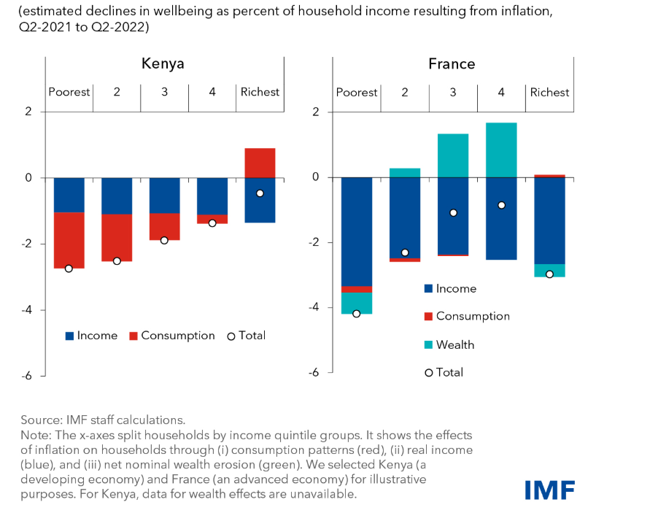
Ditsributive effects of inflation

Slide 7
What will We do in this presentation?
Focus on
The measurement of inflation inequality
Fiscal vs. monetary policies to address the inflation surge
Inflation inequality estimates are not available in real time. We construct monthly inflation indicators in the euro area from Eurostat data
Look at a simple replicable methodology to estimate inflation by income groups, age, etc.
Central banks target average inflation, but its impact is uneven across households

Slide 8
outline
Methodology
Results
Implications for fiscal/monetary policy
Mutiple choice questions

Slide 9
Methodology

Slide 10
HOW TO CalculatE inflation by household categories?
Baseline approach (ECB, OECD, Bruegel, etc.) uses surveys’ consumption baskets, to compute inflation at household categories (income level, age, area, etc.)
Baseline approach = Linked data HICP x Households budget survey by product (COICOP)
Advantages of the baseline approach
covers the full consumption basket of households
cross-country comparability
Assumptions
no behavioral/substitution effects (idem CPI in general)
ignores intra-category household heterogeneity
representative consumption baskets of 2020 (HBS generally available every 5 years in euro area)

Slide 11
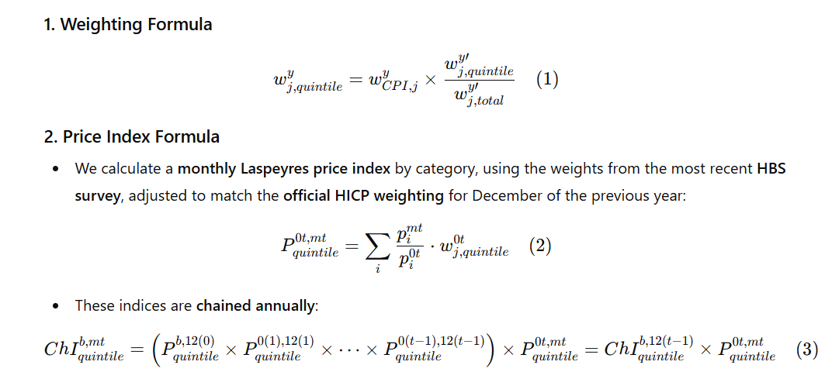
Formulas
Idea: keep official CPI weights but distribute them across income quintile

Slide 12
Replication packages
Jaravel (2024) Distributional CPI: monthly consumer price indices by socio-demographic groups (consistent with official release)
DCPI | mysite (in R)
Euro area HICP: easy access to data from Eurostat’s website, computation of many indices (Laspeyres, Paasche, chained indices, etc.)
Introduction to the hicp-package (in R)

Slide 13
2. Results

Slide 14
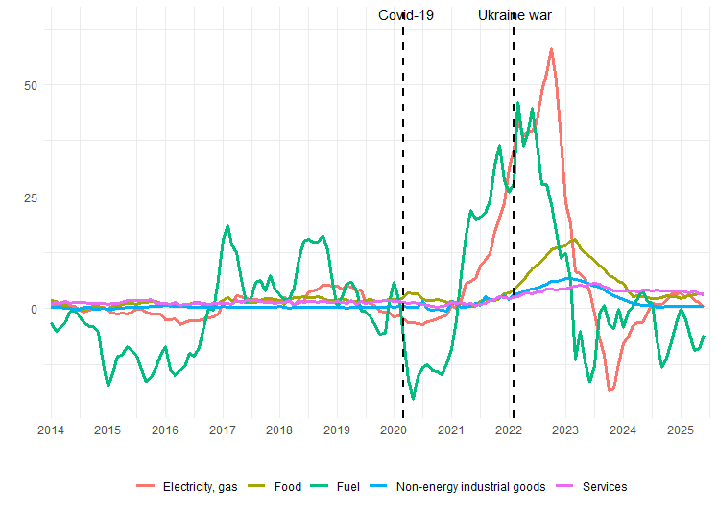
FROM RELATIVE PRICE SHOCKs AND CONSUMER BASKET DIFFERENCES TO HETEROGENEOUS INFLATION EFFECTS
Large variation between products categories
Inflation across HICP components (euro area, %, yoy)
Source: Eurostat, HICP

Slide 15
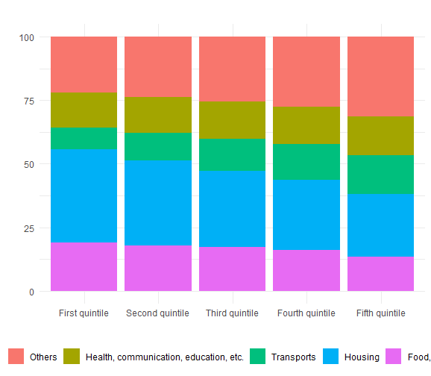
Different consumer baskets for different categories of households (propensity to consume)
Consumption baskets by income (euro area, in % of total expenditures)
Source: Eurostat, Households budget survey

Slide 16
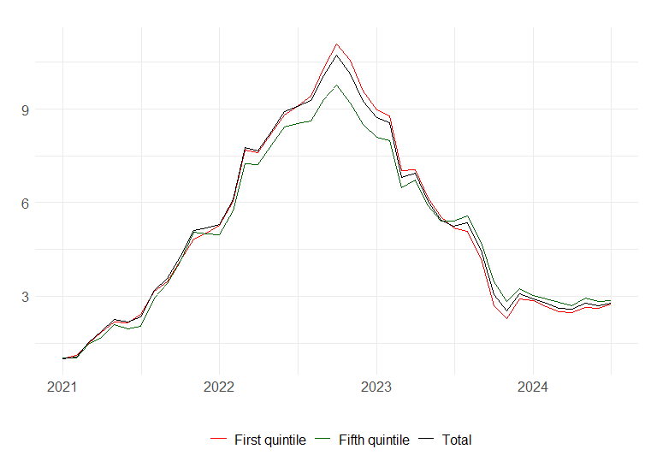
FROM RELATIVE PRICE SHOCK AND CONSUMER BASKET DIFFERENCES TO HETEROGENEOUS INFLATION EFFECTS
Inflation by income quintiles (euro area, in %)
Source: Eurostat, BdF calculations

Slide 17
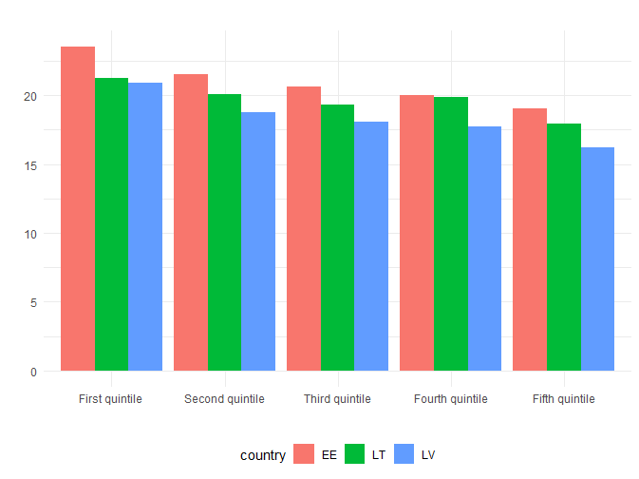
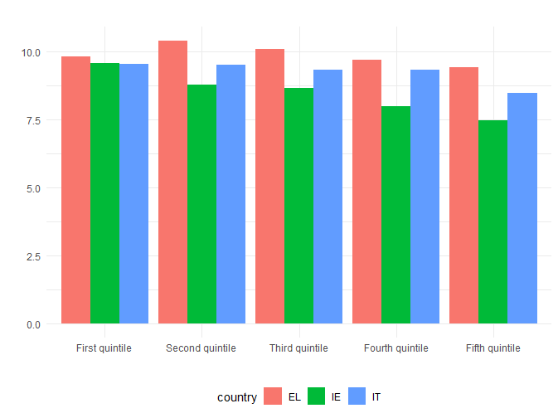
Inflation inequality: cross country heterogeneity
Large inflation inequalities
Baltic countries
Greece, Ireland, Italy
Q1 – Q5 >> 0
Q1 – Q5 > 0
Inflation by income quintiles (2022, in %)
Source: Eurostat, BdF calculations

Slide 18
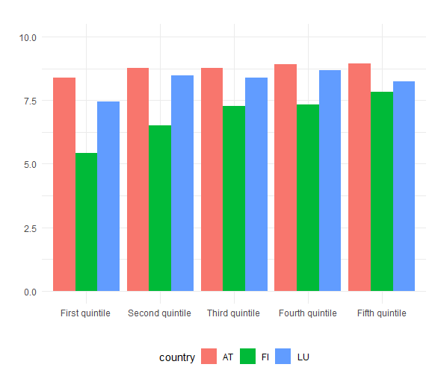
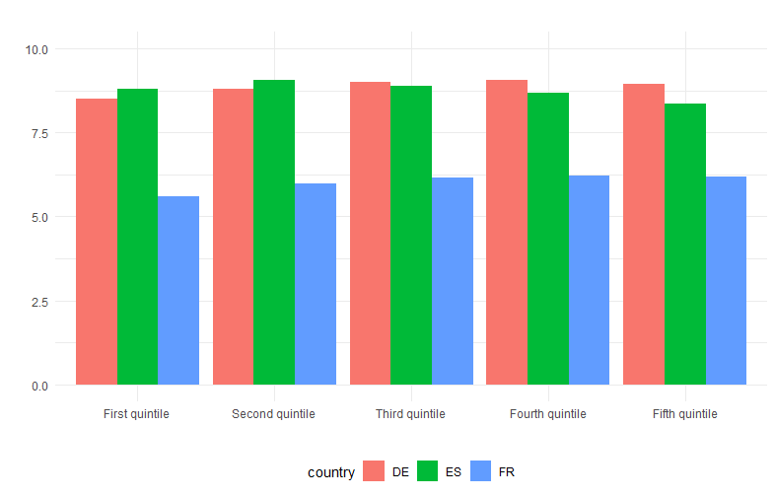
Inflation inequality: cross country heterogeneity
Germany, Spain, France
Austria, Finland, Luxembourg
Q1 – Q5 < 0
Q1 – Q5 ~ 0
Inflation by income quintiles (2022, in %)
Source: Eurostat, BdF calculations

Slide 19
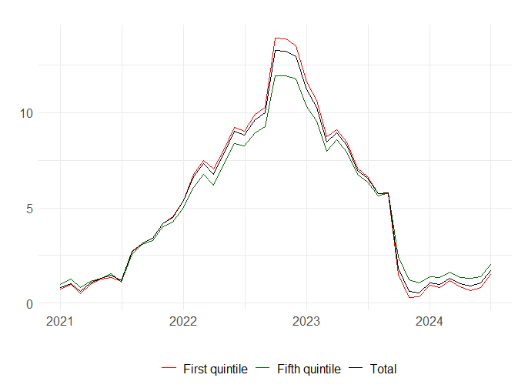
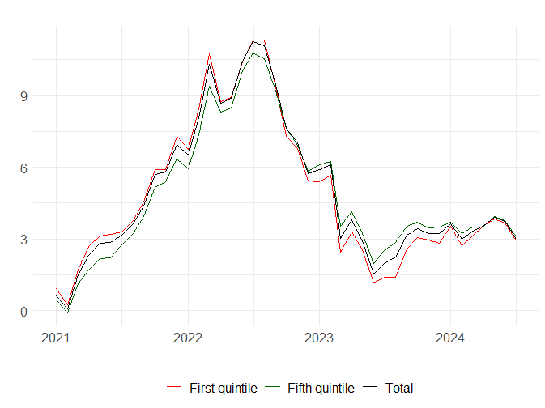
Inflation inequality: developments
Inflation by income quintile (quintile 1, quintile 5) (in %)
Italy
Spain
Source: Eurostat, BdF calculations

Slide 20
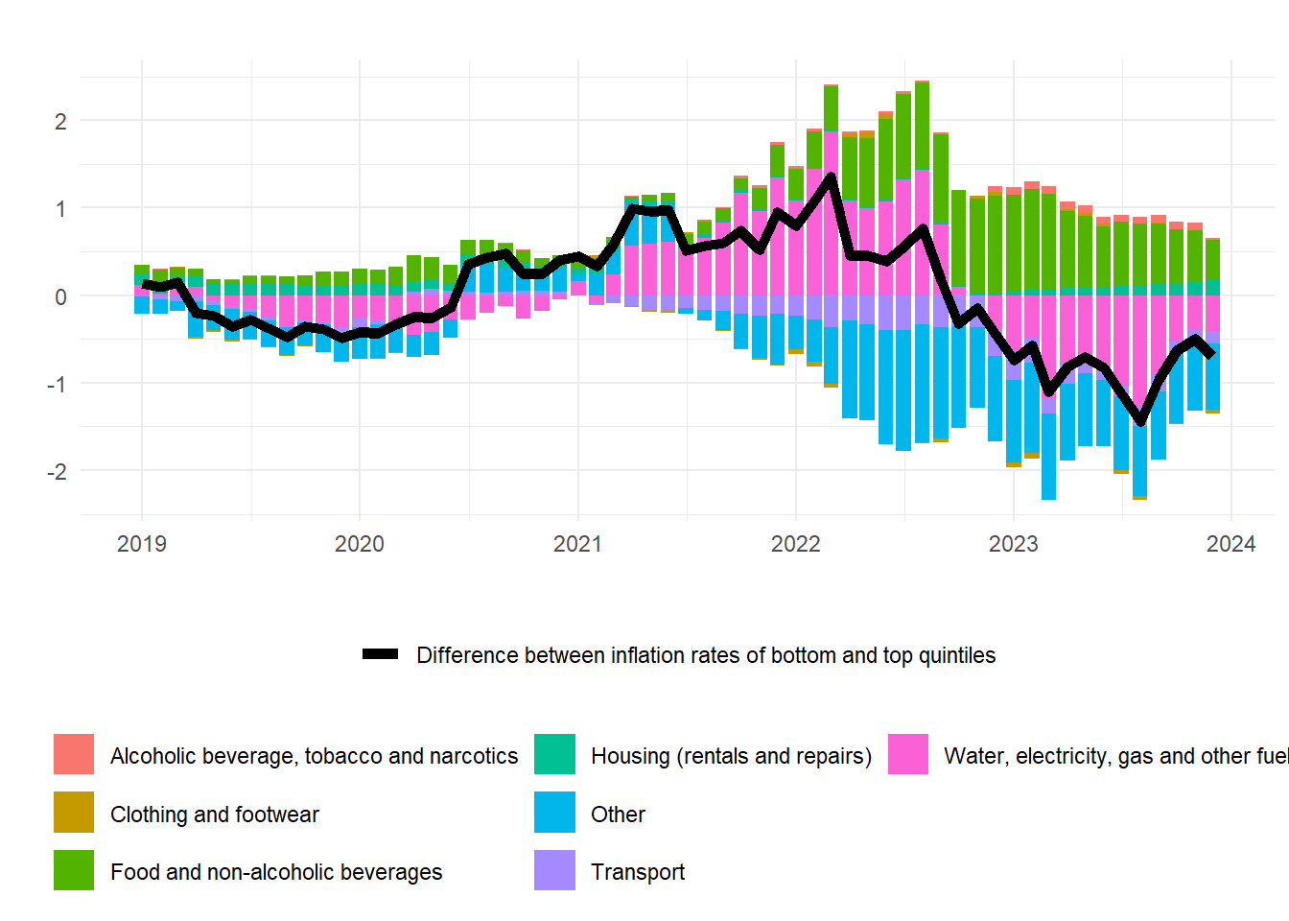
Contribution to inflation inequality in SPAIN
In 2022, the product contributions to the inflation gap offset each other (energy vs. services).
In 2023, the rise in food prices affects more low-income households
Product contributions to inflation gap (in pp)
(Q1-Q5)
Source: Eurostat, BdF calculations

Slide 21
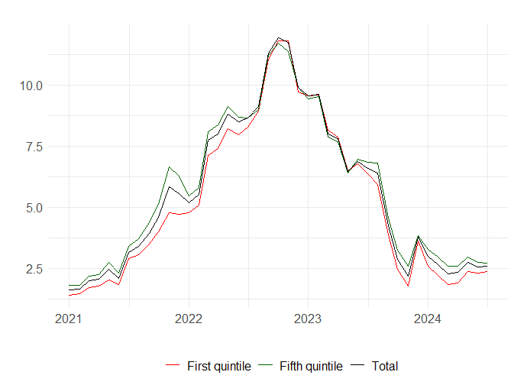
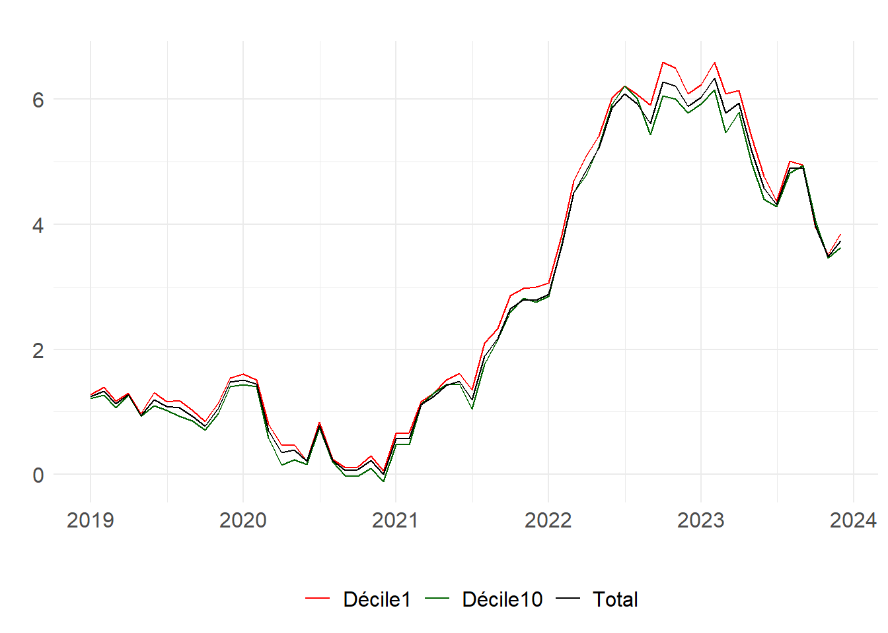
Inflation inequality: developments
Inflation by income quintile (quintile 1, quintile 5) (in %)
Germany
France
Source: Eurostat, BdF calculations

Slide 22
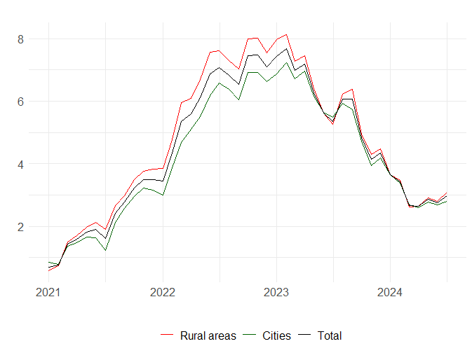
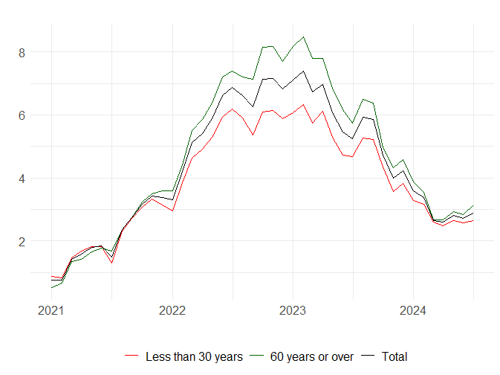
Inflation inequality by age and area of residence is more pronounced
Inflation by household categories in France ( in %)
a) By residence area
b) By age
Source: Eurostat, BdF calculations

Slide 23
Long-Run Inflation Inequality by Income quintiles
France, index-100 in 2010

Slide 24
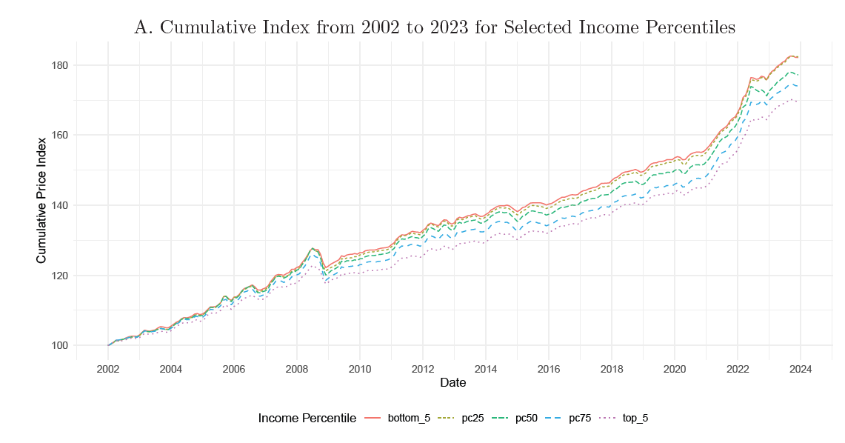
Long-Run Inflation Inequality by Income Percentiles in the US
Source: Jaravel (2024)

Slide 25
3. Implications

Slide 26
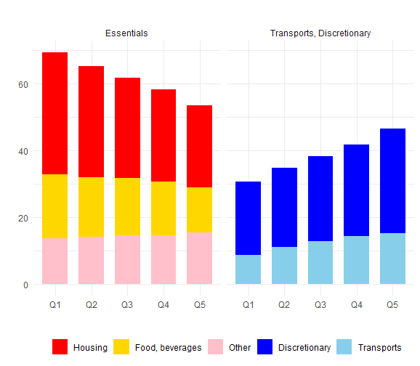
Low-income households spending proportionally more on essential expeNdiTUres
Consumption baskets by income quintile
(Euro area, share of total expenditure, in %)
Rich households have more leeway to cushion price by reducing certain expenditures (leisure, etc.) or substituting towards cheaper expenditures.
“Other” includes health, communications, education
“Discretionary” includes all remaining
Source: Eurostat

Slide 27
The effect of energy price freeze policies on inflation inequality
Governments have implemented a wide variety of measures during the energy prices crisis
Prices measures directly affecting gas, electricity, and fuel prices through VAT reductions or price ceilings (contrary to measures on revenues)
Fiscal policy contributed to alleviating the negative impact of inflation on households through temporary support measures (energy tariff shields, VAT cuts)

Slide 28
Mitigating the Effects of Inflation: monetary policy
Inflation has distributional effects…
…But the hikes in the ECB's director rate in 2022 and 2023 have distributional effects (directly and indirectly via labor market):
savers benefit from MP with higher returns on deposits, borrowers face higher debt servicing costs, reducing disposable income
Impacting lower-income households by limiting job opportunities and wage growth (not clear during the last episode)
↑ Interest Rates -> ↑ Borrowing Costs -> ↑ Real Debt Costs → ↓ Wealth (Debtors)
-> ↑ Returns on Savings → ↑ Wealth (Savers)
↑ Interest Rates -> ↓ Labor Market -> ↓ Revenues -> ↓ ↓ Bottom 50, Top 10
-> ↓ Middle 40

Slide 29
Mitigating the Effects of Inflation
VAT reduction, tariff shields policies have direct effects on prices, while the transmission lag for monetary policy is generally estimated to be around 18 months.
Fiscal policy can affect relative prices (energy) vs monetary policy affects the aggregate price level
In the long run, only monetary policy is effective in bringing inflation back to its target (2% in the euro area)

Slide 30
Conclusions
Simple approach of inflation inequalities that can be extended to many countries
Inflation inequality patterns may differ across countries and time (Long-run vs. short-run)
Understanding the heterogeneous effects of inflation is important to analyze policies effectiveness during the energy crisis of 2022-23

Slide 31
main takeaways
Inflation inequality throughout income distribution varies between countries in the euro area but not greatly within the largest European countries (except Italy) due to fiscal policies
In larger countries, the inflation gap (Lower quintile – Top quintile) is close to 0 but inflation differentials are more significant regarding age or area (urban vs. rural)
Rural households may face higher energy inflation than urban households due to longer transportation distances and fewer alternatives

Slide 32
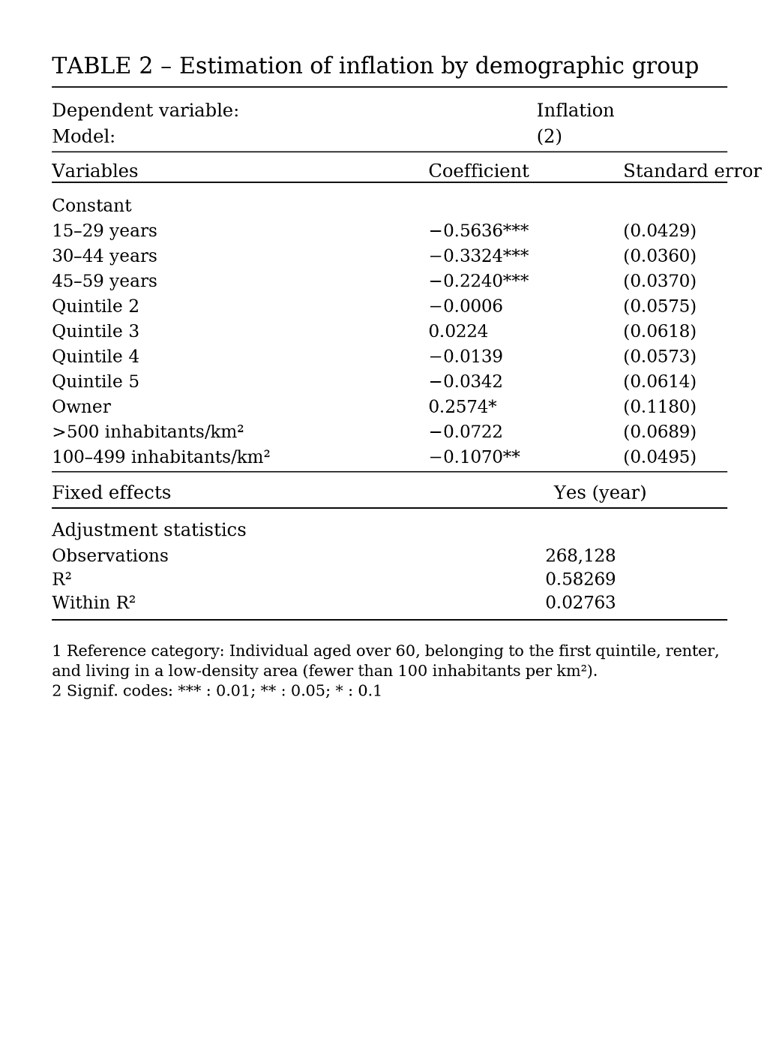
Personal inflation rate
Overlapping effects: similar relationships between subgroup rates may be as a result of overlapping subgroup membership
New approach at household level to disentangle different subgroups

Slide 33
POLICY References
OECD (2022) Surging energy prices are hitting everyone, but which households are more exposed? – ECOSCOPE (oecdecoscope.blog)
IFS (2022) Inflation hits 9% with poorest households facing even higher rates - Institute For Fiscal Studies – IFS
ECB (2022) The impact of the recent rise in inflation on low-income households (europa.eu)
ECB (2023) The impact of the recent inflation surge across households (europa.eu)
IMF (2023) Fiscal Policy Can Help Tame Inflation and Protect the Most Vulnerable
Bruegel (2022) Inflation inequality in the European Union and its drivers (bruegel.org)

Slide 34
ACADEMIC References
Argente, D., & Lee, M. (2021). Cost of living inequality during the great recession. Journal of the European Economic Association, 19(2), 913-952.
Cardoso, M., Ferreira, C., Leiva, J. M., Nuño, G., Ortiz, Á., Rodrigo, T., & Vazquez, S. (2022). The heterogeneous impact of inflation on households balance sheets. WP
Gautier Montornès (2024) The Heterogeneous Effects of Inflation in France and in the Eurozone | Cairn.info
Hobijn B, Lagakos D. (2005). Inflation inequality in the United States. Rev. Income Wealth 51(4):581–606
Jaravel, X. (2021). Inflation inequality: Measurement, causes, and policy implications. Annual Review of Economics, 13, 599-629.
Kaplan G, Schulhofer-Wohl S. (2017). Inflation at the household level. J. Monet. Econ. 91:19–38

Slide 35

https://www.menti.com/ale1gfpjfcy2

Slide 36
scanner data
Our baseline approach can only capture the part of inflation inequality that arises between broad household categories (e.g., Q1 and Q5)
New literature on “inflation inequality” is emerging with the availability of scanner data: Nielsen, Kantar (e.g. Kaplan, Schulhofer-Wohl, 2017)
Aggregation bias is significant, necessitating micro-level data to properly measure expenditure shares, effective prices, and product variety for various sociodemographic groups. On average in the 2010’s
US Baseline approach (CPI*CEX): inflation gap = 0.37 pp
New approach (Scanner data): inflation gap = 0.66 pp

Slide 37
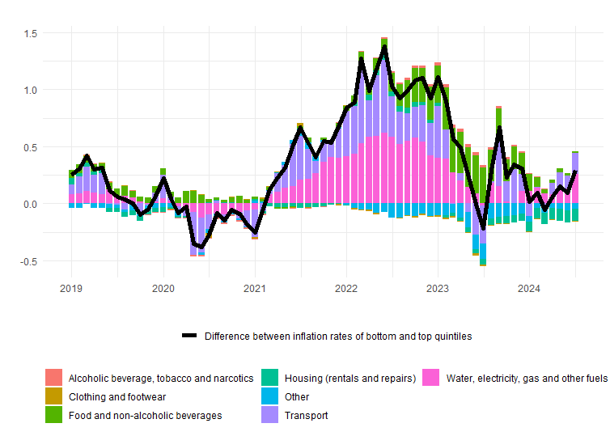
Contribution to inflation inequality in FRance
Electricity/gas bills and transport contribute most to the gap between urban and rural areas
Product contributions to inflation differential Rural – Urban (in pp, France)
(Rural-Urban)
Source: Eurostat, BdF calculations

Slide 38
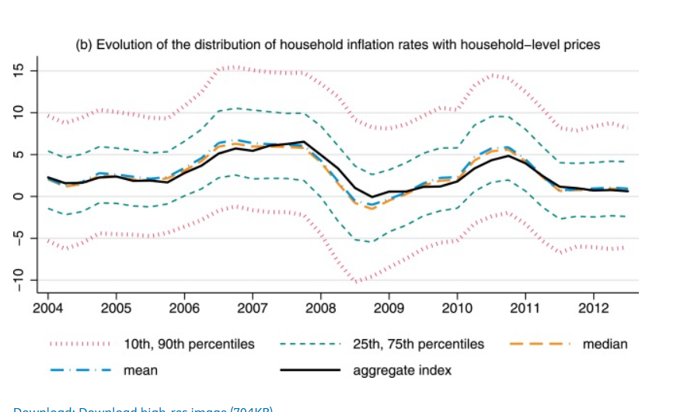
The dispersion of household-level inflation rates

